Slide 1
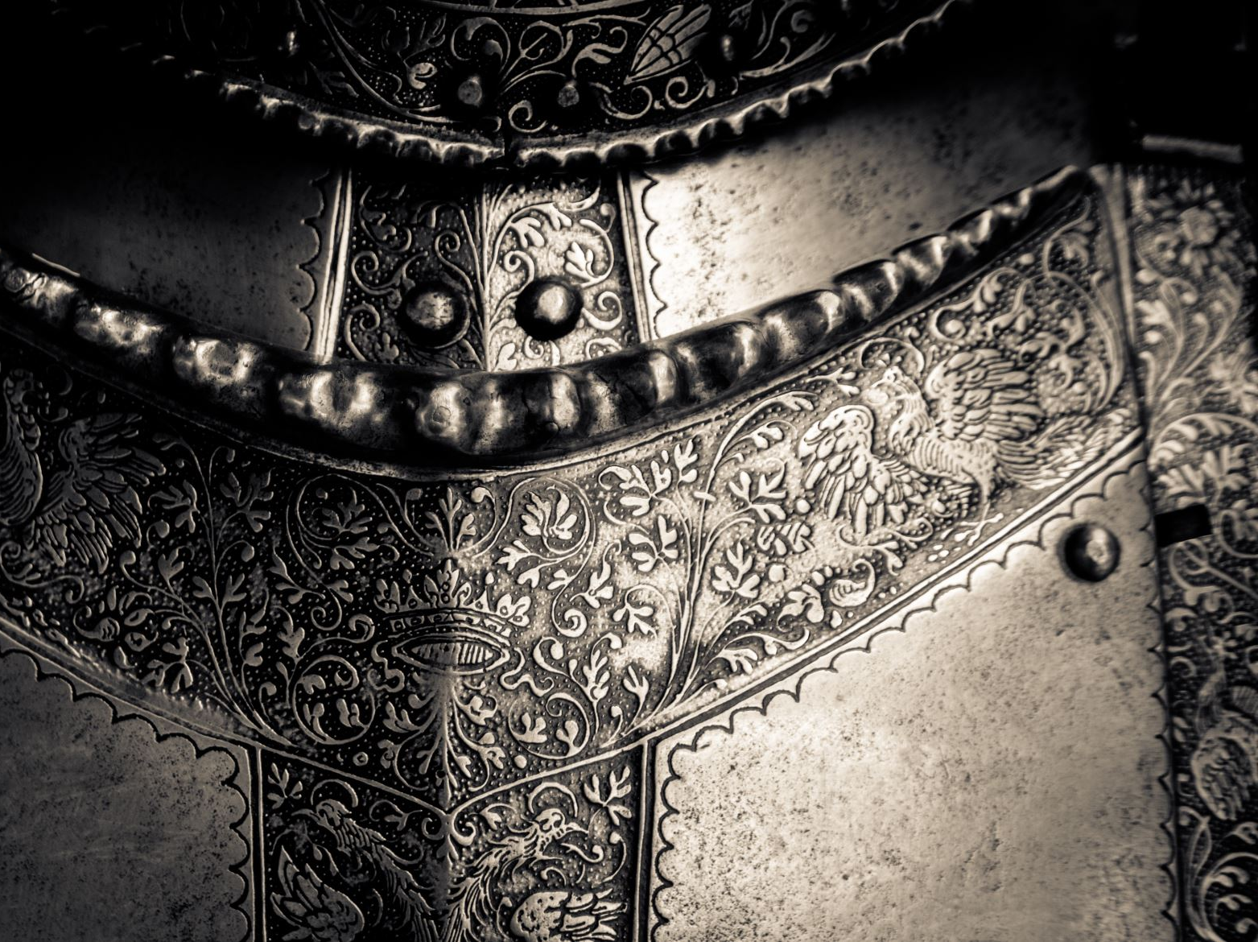
The Late Middle Ages
Week 7

Slide 2
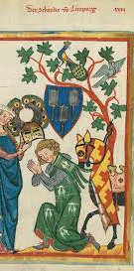

The Age of Chivalry
Edward III and his son, the Black Prince, were greatly admired in England for their courage on the battlefield and for their courtly manners. They become symbols of the code of “chivalry”, the way in which a perfect knight should behave.

Slide 3

11th-century French epic poem “Song of Roland,” describes this code. Here are 17 entries as listed:
To fear God and maintain His Church
To serve the liege lord in valor and faith
To protect the weak and defenseless
To give succor to widows and orphans
To refrain from the wanton giving of offense
To live by honor and for glory
To despise pecuniary reward
To fight for the welfare of all
To obey those placed in authority
To guard the honor of fellow knights
To eschew unfairness, meanness, and deceit
To keep faith
At all times to speak the truth
To persevere to the end in any enterprise begun
To respect the honor of women
Never refuse a challenge from an equal
Never turn your back upon a foe
:

Slide 4
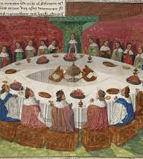
Round Table
King Arthur Legend

Slide 5
Chivalry was a useful way of persuading men to fight by creating the idea that war was a noble and glorious thing. (Profitable, as well☺

Slide 6
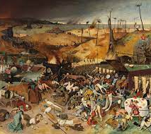
Plague (1348)

Slide 7
It decreased the population of people and animals
Famine
Agricultural poverty
  (+)Expensive labor
  (+)Emergence of a new class «yeomen»
  (+)replacement in the exportation of wool (raw material) with finished clothes (FLEMING, the surname for those people who are skilled clothmakers)
  «Spinsters» (unmarried women)

Slide 8
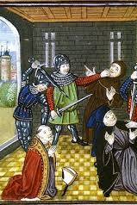
Peasant’s Revolt
The new taxes and discontent with the Richard II and feudal system led to the revolt.
Also, the landlords were forcing the peasants back into serfdom, because of economic reasons.
The leader of the revolt, Wat Tyler, called for a fair treatment of England’s poor people:
“We are men formed in Christ’s likeness and we are kept like animals.
When Adam delved and Eve span,
Who was then the gentleman?”
Richard II: Serfs you are and serfs you shall remain.

Slide 9
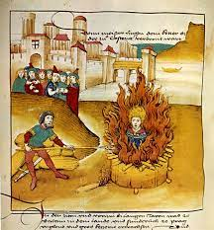
Heresy and Church
The discontent with the church
*greedy
*cruelty
*paying tax to the pope
*the spread of religious writings
*the increase in private prayer
Heresy was known as Lollardy (to say prayers)
John Wycliffe, an Oxford professor. He believed that everyone should be able to read the Bible in English and to be guided by it in order to save their soul.
Lollards were burnt alive

